Slide 1
Design and experimental verification of
underactuated prosthetic hand
School of Biological Science and Medical Engineering,
Beihang University
Reporter：Jianan Zhang
corresponding author：Yu Wang
Notes:
Good afternoon everyone, I am very honored to give this speech about the Design and experimental verification of under-actuated prosthetic hand.
Today I would like to present the results of our studies performed at Beihang University.

Slide 2
1
ABSTRACT
Underactuated prosthetic hand
Underactuated prosthetic hand has attracted growing attention due to its light weight and easy control. In this paper a single linear motor is used to drive the prosthetic hand, and the palm of the hand has three arches similar to that of human hands. Besides a series of experiments were carried out to test the power grasp and the precision grasp function of the prosthetic hand. The factors influencing the success rate of power grasp and the stability of precise grasp are analyzed, and the direction to improve its performance and usability is given.
Notes:
Under-actuated prosthetic hand has attracted growing attention due to its light weight and easy control. In this paper a single linear motor is used to drive the prosthetic hand, and the palm of the hand has three arches similar to that of human hands. Besides a series of experiments were carried out to test the power grasp and the precision grasp function of the prosthetic hand. The factors influencing the success rate of power grasp and the stability of precise grasp are analyzed, and the direction to improve its performance and usability is given.

Slide 3
2
INTRODUCTION
Reasons for prosthetic abandonment:
The difference between the perceived needs of ULAs and the functionality of prosthetics.
Consumers' double high standards for the form and function of prosthetic hands.
How to achieve dexterous grip control through simple operation form？
A new underactuated prosthetic hand based on the continuum structure.
Grip performance test of the prosthetic hand.
Indicate directions for further optimization of prosthetic hands.
Notes:
The reasons for prosthetic abandonment include: the difference between the perceived needs of ULAs and the functionality of prosthetics; and consumers' double high standards for the form and function of prosthetic hands.
The biomimetic form of prosthetic hands is a basic requirement, and the dexterity and ease of manipulation of their functions are also important aspects of prosthetic hand design, which however have been contradictory in many previous designs. Therefore, how to achieve dexterous grip control through simple operation form is an important subject worth studying.
In this paper, we present a new under-actuated prosthetic hand based on continuum structure and explore the methods to improve its bionics and synergy. Experiments were carried out to test the grasp performance of the prosthetic hand and indicate directions for further optimization of prosthetic hands.

Slide 4
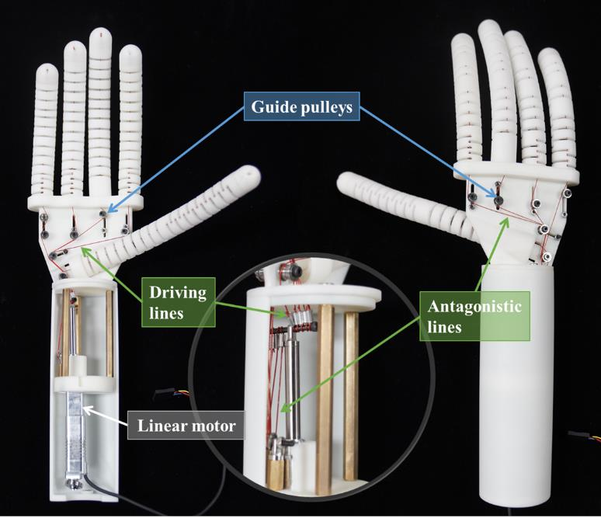
3
DESIGN
Keywords
The underactuated prosthetic hand has humanlike size with the weight of 273.2g (excluding power supply and microcontroller development board) and is driven by a single linear motor.
Bionic Palm
Adjustable Stiffness
Light
Fig. 2. The underactuated prosthetic hand.
Notes:
As shown in fig. 2 the under-actuated prosthetic hand has humanlike size with the weight of 273.2g and is driven by a single linear motor. The light weight is one of the greatest strengths, and the bionic palm and the adjustable stiffness feature will be discussed in detail.

Slide 5
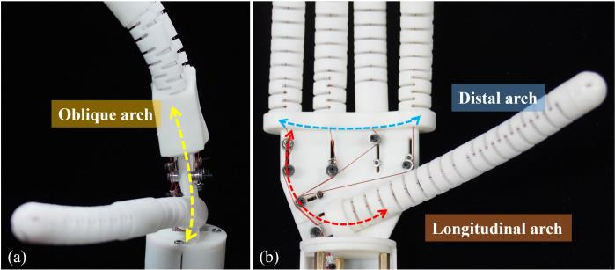
3
DESIGN
A. Bionic Palm Design
The palmar concavity results from the formation of three arches that run in different directions as shown in Fig. 1.
Oblique arch
Distal arch
Longitudinal arch
Pre-shaping
Fig. 1. (a) The yellow line represents the oblique arch of the prosthetic hand. (c) The blue line represents the distal arch and the red line represents the longitudinal arch of the prosthetic hand.
The angle of distal arch is set as a fixed value of 140°.
Modulations in longitudinal arch angle is directly related to the outreach movement of the thumb.
The deformation of oblique arch can be observed when applying a load to the prosthetic hand, which is related to the flexibility of the palm material.
Notes:
Pre-shaping characteristics of the hand are important for successful grasp. In order to improve the grasping performance of the prosthetic hand, the radian characteristics of the palm of the hand are taken into account, so that the curvature of the palm can match the bending of the fingers to form the pre-shaping feature of the hand.
The palmar concavity results from the formation of three arches that run in different directions as shown in Fig. 1. The angle variation range of distal arch is the smallest so it is set as a fixed value of 140°. Modulations in longitudinal arch angle is directly related to the outreach movement of the thumb, and the deformation of oblique arch can be observed when applying a load to the prosthetic hand, which is related to the flexibility of the palm material.

Slide 6
3
DESIGN
B. Underactuated Structure
The prosthetic hand is driven by a single linear motor, when the finger flexes or extends, the length of the drive lines and reset lines vary by the same amount.
Reset lines’function:
Allow the finger to reduce its reset time during extension.
Ensure that the finger can still maintain its original posture after multiple flexions.
Provide antagonistic effect—— change the stiffness of the finger.
Fig. 2. The underactuated prosthetic hand.
Notes:
Each finger of the prosthetic hand has bending and abduction freedom except the middle finger, and when grasping objects, the compliance of the finger will greatly increase the diversity of finger trajectory.
As shown in Fig. 2, the prosthetic hand is driven by a single linear motor, when the finger flexes or extends, the length of the drive lines and reset lines vary by the same amount. The reset lines on the opposite side of the driving lines are of great help to improve the grasp performance of the prosthetic hand.
On the one hand, the reset line allows the finger to reduce its reset time during extension, while ensuring that the finger can still maintain its original posture after multiple flexions; on the other hand, the reset line can provide antagonistic effect: when adjusting the initial position of the finger, the stiffness of the finger can be changed by adjusting the length of the reset line, which helps the prosthetic hand to adapt to different stiffness objects.

Slide 7
4
EXPERIMENTS
Functional tests
Power Grasp, Precision Grasp, Fingertip Trajectory
This section will introduce the methods of experiments were conducted to test functions and motion characteristics of the prosthetic hand.
Power Grasp Test
Stability Test of Precision Grasp
Fingertip Trajectory Test
In the experiment healthy subject was asked to use the prosthetic hand to grasp, transfer and place the six objects.
Pull the tension sensor horizontally to record the external force when grasping instability and repeat for ten times to take the average value.
change the displacement of the linear motor, and record the movement track of the fingertips in the opening and closing action.
Notes:
The third part will introduce the methods of experiments were conducted to test functions and motion characteristics of the prosthetic hand.

Slide 8
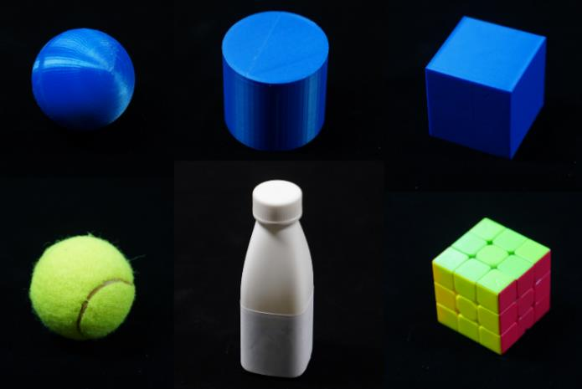
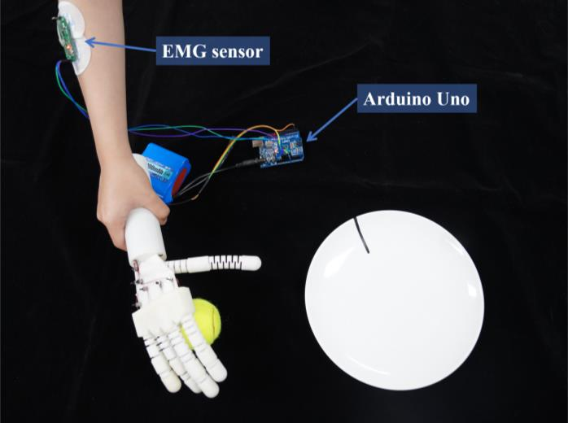
4
EXPERIMENTS
A. Power Grasp Test
In the experiment healthy subject was asked to use the prosthetic hand to grasp, transfer and place the six objects in Fig. 3. with one hand.
If the object falls during grasping or transfer, it is a failure. It should be noted that only the prosthetic hand is allowed to contact the object during the above operation.
Fig. 3. Six objects selected for grasping test.
The electromyographic (EMG) sensor is attached to the brachioradialis muscle of the right arm of the subject.
Before the experiment, the subject needs to control the contraction and relaxation of brachioradialis muscle according to the instructions, and a reasonable threshold is set according to the changes of the EMG signal.
Fig. 4. Subject was using the prosthetic hand to grasp a tennis ball.
Notes:
In the power grasp test, healthy subject was asked to use the prosthetic hand to grasp, transfer and place the six objects in Fig. 3. with one hand. The initial position of the object is about 30cm away from the target position. If the object falls during grasping or transfer, it is a failure. It should be noted that only the prosthetic hand is allowed to contact the object during the above operation.
The EMG sensor is attached to the brachioradialis muscle of the right arm of the subject. Before the experiment, the subject needs to control the contraction and relaxation of the muscle according to the instructions, and a reasonable threshold is set according to the changes of the EMG signal.

Slide 9
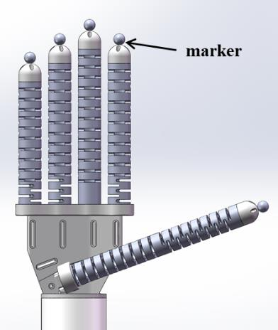
4
EXPERIMENTS
B. Stability Test of Precision Grasp
The prosthetic hand is fixed on the experimental platform to accurately grasp a light object (regardless of its gravity). Pull out the object horizontally and record the external force when grasping instability and repeat for ten times to take the average value. Change the displacement of the linear motor and repeat the above experiment.
C. Stability Test of Precision Grasp
As shown in Fig. 5 markers were fixed on the fingertips of the prosthetic hand, and the Polaris Vega® was used to track the position of the markers. Keeping the initial posture of the prosthetic hand unchanged, change the displacement of the linear motor, and record the movement track of the fingertips in the opening and closing action.
Fig. 5. Placement of markers on each finger of the prosthetic hand.
Notes:
The second part is Stability Test of Precision Grasp. The prosthetic hand is fixed on the experimental platform to accurately grasp a light object. Pull out the object horizontally and record the external force when grasping instability and repeat for ten times to take the average value. Change the displacement of the linear motor and repeat the above experiment.
The next test is Fingertip Trajectory Test. As shown in Fig. 5 markers were fixed on the fingertips of the prosthetic hand, and the Polaris Vega® was used to track the position of the markers. Keeping the initial posture of the prosthetic hand unchanged, change the displacement of the linear motor, and record the movement track of the fingertips in the opening and closing action.

Slide 10
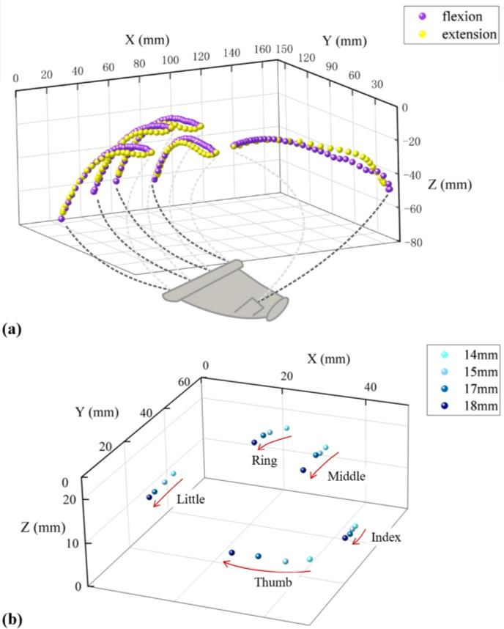
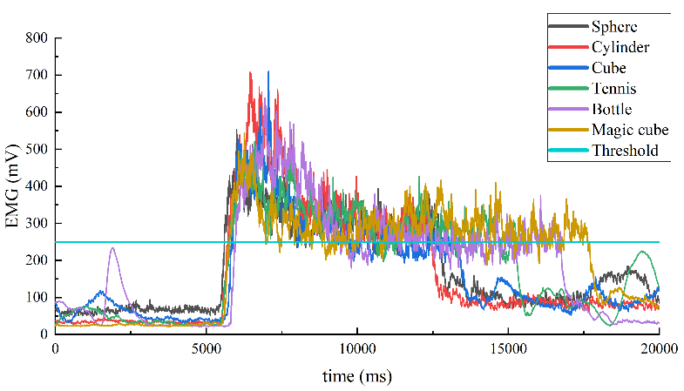
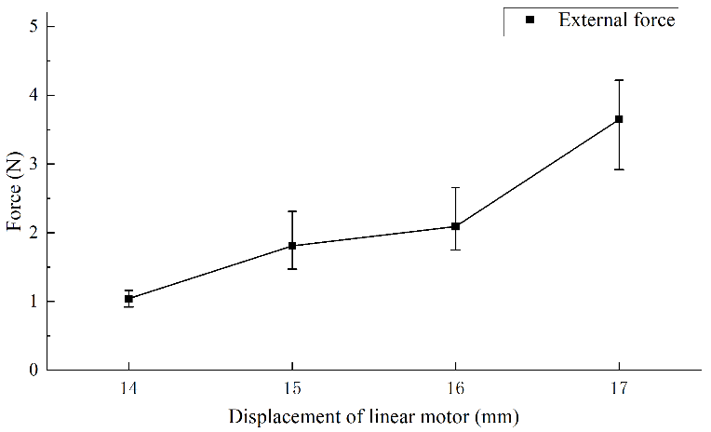
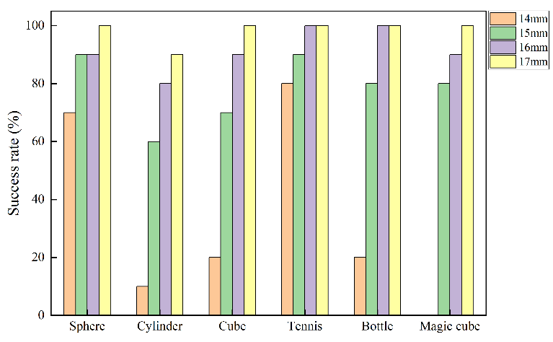
5
RESULT AND DISCUSSION
Results & Discussion
After the experiment, the experimental results were summarized and discussed to analyze the future direction of prosthetic hand optimization.
Notes:
After the experiment, the experimental results were summarized and discussed to analyze the future direction of prosthetic hand optimization

Slide 11
5
RESULT AND DISCUSSION
A. Kinematic Characteristics of Prosthetic Hand
In actual movement, the friction force on the driving lines will lead to the low coincidence of the motion trajectory of the thumb fingertip in the reciprocating movement.
The initial and final fingertip positions of the prosthetic hand remain basically unchanged after several open and close movements.
The fingers are more gathered while the bending degree increases, which is consistent with the motion characteristics of the human hand.
Fig. 6. (a) The opening and closing trajectory of the fingertip. (b) Convergence of fingertip position during sustained flexion.
Notes:
The trajectories we got before were used to analyze the influence of the degree of flexion of the prosthetic hand in the grasping process on the success rate of power grasping and the stability of precision grasping.
As shown in Fig. 6 (a). The flexion trajectories of the fingertips are highly coincident with the reduction trajectory except for thumb. This is related to the number of driving lines. There are two pairs of thumb driving lines, corresponding to the extension-adduction and flexion-extension. However, each of the other four fingers is driven by only one pair of driving lines (a driving line and a reset line). In actual movement, the friction force on the driving lines will lead to the inconsistent change speed of the length of the two pairs of driving lines in thumb, resulting in the low coincidence of the motion trajectory of the thumb fingertip in the reciprocating movement.
Well, since the length change of each pair of driving lines is constant, the initial and final fingertip positions of the prosthetic hand remain basically unchanged after several open and close movements, which also verifies the effect of the reset lines on maintaining the initial posture of the prosthetic hand.
Let's move on to figure B, as we can see, as the displacement of the linear motor increases, the fingers are more gathered while the bending degree increases, which is consistent with the motion characteristics of the human hand, whereas in previous designs of prosthetic hands, the four fingers usually remain parallel in bending. And the convergence characteristic of prosthetic hand is due to the optimization of palm configuration.

Slide 12
5
RESULT AND DISCUSSION
B. Success Rate of Power Grasp
The grasping success rate increases with the increase of linear motor displacement.
Increasing the convergence of the finger of the prosthetic hand can improve the success rate of power grasping.
With the traction of the driving line, both fingers and palms will produce elastic deformation.
Improving the compliance of EMG control and reducing the operation burden of users are the key to improve the availability of prosthetic hand in the future.
Fig. 7. The grasping success rates of six experimental objects corresponding to different displacements of linear motor.
Fig. 8. Electromyography in six object grasping tests.
Notes:
The grasping success rates of six experimental objects corresponding to the displacement of linear motor is shown in Fig. 7. For the six objects selected in the experiment, the grasping success rate increases with the increase of linear motor displacement, which is more obvious in the grasping of non-spherical objects.
In addition, when grasping spherical objects, this prosthetic hand can achieve a high success rate even when the fingers are less bent, which fully reflects the features and advantages of the prosthetic hand's convergence. The above results indicate that increasing the convergence of the finger of the prosthetic hand can improve the success rate of power grasping, which is of great significance to improve the ability of the prosthetic hand to perform ADL.
The compliance of the prosthetic hand plays an important role in power grasping. With the traction of the driving line, both fingers and palms will produce elastic deformation. The fingers will bend first and continue to slide along the surface of the object to achieve a larger envelope and contact area after touching the object. If the linear motor is still moving forward when all fingers are restricted by the object, the palm of the hand will bend inwards. Since the stiffness of the palm is greater than that of the finger, the grabbing power of the fingertips will increase at the same time, thus increasing the success rate of the
power grasping.
What’s more , the feeling of the participants using the EMG sensor in the experiment is also one of the factors affecting the success rate of grasping. As we can see in Fig. 8. when grasping an object, the subject tends to continue to exert a high intensity force in order to maintain the stable grip of the object, which is much higher than that need to maintain the flexion of the prosthetic hand. After the experiment, some subjects responded that the grasping process was laborious and the forearm felt sore. Therefore, improving the compliance of EMG control and reducing the operation burden of users are the key to improve the availability of prosthetic hand in the future.

Slide 13
5
RESULT AND DISCUSSION
C. Stability of Precise Grasp
The precision grip stability of the prosthetic hand increases significantly, which is related to the stiffness change of the finger during flexion.
The deformation of the finger from the non-grasping state to the grasping state is the source of the positive pressure exerted by the fingertip on the object.
Improving the stiffness of the prosthetic hand is conducive to improving the stability of accurate grasping.
Fig. 9. External force when precise grasping is not stable.
Notes:
The experimental results of the precise grasping test of the prosthetic hand are shown in Fig. 9. As the displacement of the driving line increases, the precision grip stability of the prosthetic hand increases significantly, which is related to the stiffness change of the finger during flexion: as the bending degree increases the stiffness of the finger increases at the same time. When the displacement of the driving line is the same, the deformation of the finger from the non-grasping state to the grasping state is the source of the positive pressure exerted by the fingertip on the object, which is proportional to the detachment force measured in the experiment. Therefore, improving the stiffness of the prosthetic hand is conducive to improving the stability of accurate grasping.

Slide 14
6
CONCLUSION
The above design reduces the weight of the prosthetic hand and makes it more convenient for ULAs to use.
To further improve the grasping performance of the prosthetic hand, the stiffness of the finger needs to be adjustable to improve the compliance of the prosthetic hand to the stiffness of the grabbed object.
The optimization of prosthetic hand in the future also includes improving the compliance of EMG control to reduce the operation burden of ULAs.
The actuation would be improved by using a high torque steering motor to make the structure compact.
CONCLUSION
Notes:
In conclusion, we proposed a new structure design and driving scheme of the prosthetic hand. The bionic designed palm configuration is verified by the fingertip motion track test and the power grasping experiment. The antagonistic (reset) line and movable guide pulleys are added to adjust the initial posture and initial stiffness of the finger; and the prosthetic hand is driven by a single motor, which can be controlled by EMG.
The above design reduces the weight of the prosthetic hand and makes it more convenient for ULAs to use. Adjusting the displacement of the linear motor can improve the compliance of the prosthetic hand to the shape of the object, but to further improve the grasping performance of the prosthetic hand, the stiffness of the finger needs to be adjustable to improve the compliance of the prosthetic hand to the stiffness of the grabbed object.
The optimization of prosthetic hand in the future also includes improving the compliance of EMG control to reduce the operation burden of ULAs. In addition, the actuation would be improved by using a high torque steering motor to make the structure compact.

Slide 15
THANKS FOR LISTENING
THANKS TO RCAE

